Slide 1
HOW TECHNOLOGY CAN IMPROVE FOOD INSECURITY
June 2024 Sade Watson

Slide 2
Table of Contents
01
02
03
04
The Issue
Local Barriers
04
What food insecurity is and it's problems.
Awareness and population density
Global & Local Solutions
Conclusion
05
Water treatments, welfare, and economic policies.
The best solutions and overall thoughts
Global Barriers
Bibliography
Monetary allocation.
06
Sources used.

Slide 3
What is Food Insecurity?
01
The Issue
The condition of not having access to sufficient food, or food of an adequate quality, to meet one's basic needs.
Notes:
Oxford languages

Slide 4
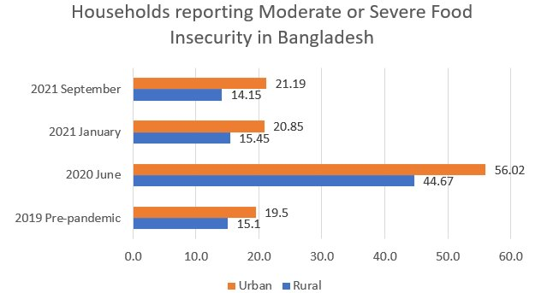
Why is this a Problem?
01
The Issue
Food insecurity is severe in lower developed counties such as Bangladesh and Niger has afflicted multiple issues on civilians.
Moreover, food insecurity presents itself to be an issue locally within the state of Florida.
Notes:
Issue that arrise from food insecurity range from acute malnutrition, stunted growth and even death. Bangladesh has the highest rate of underweight children in South Asia. One in two children below five years are chronically undernourished, and 14 percent suffer from acute malnutrition. WHO estimates that malnutrition leads to two in three deaths under the age of five.basmah.org
Niger More than 47 percent of children under five years of age suffer from chronic malnutrition. An estimated 4.4 million Nigeriens are food-insecure USAID.org- agency of the United States government that is primarily responsible for administering civilian foreign aid and development assistance.
Florida 2021, they estimated 2.2 million Floridians lack access to healthy food, and just over 660,000 are children. Feeding glorida.org

Slide 5
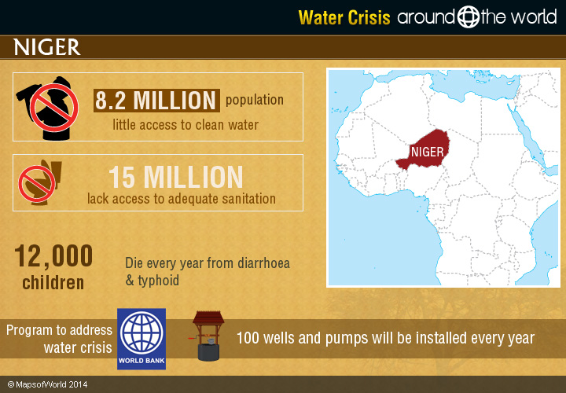
Root Causes of Food Insecurity
Poverty
The Issue
01
Water Scarcity
Natural Disasters
Notes:
limited access to arable land and water are key drivers of food insecurity. Climate change is further increasing the challenges, with increasingly irregular rainfall, ... and more droughts and floods. Morevor that 42% live below national poverty line World food program which is headed by a distinguished humanitarian with 4 decades of expirence as a business leader and diplomat with a masters deegre
Additionally scientific article writen by college researchers in the department of economics and environmental studies have identified that some of the factors of food insecurity in Bangladesh, namely natural calamities such as drought and land degradation, decrease of food production, and increased food prices
Furthermore these issues are seen locally as well in fact aan article written by a Social worker with her masters even states that one of the causes to food insecurity within the state is lack of affordability
Water Crisis Around the World | Around the World (mapsofworld.com)

Slide 6
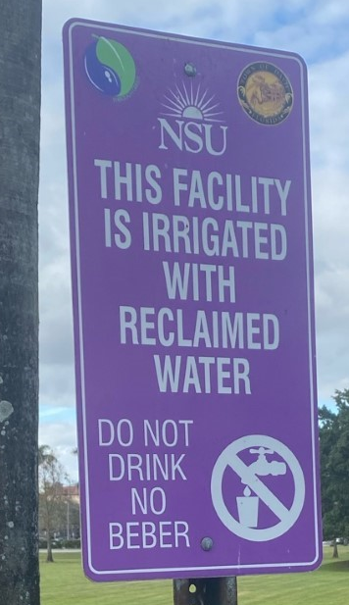
Recycled Water
02
Global and Local Solutions
Effectively used in Australia to address their water scarcity issues.
According to floridadep.gov "Florida is the national leader in water reuse, using 48 percent of total domestic wastewater."
Notes:
Now that we went over the root causes what are some of the technologies that can be implemented to alleviate these problems which will in turn solve insecurty. Well if the goal is to create wider acces to food then more food must be produced essentially. This idea revolves around the fundamental proncipal of supply and demand. The more crops that are available the less in value they will be which creates wider access to food especially across the impovershed demographic.
(Aussie ranked 12th in the world as a leading nation in food security) Rating Australia—a selection of global indexes – Parliament of Australia (aph.gov.au)
Israel is the world leader in wastewater recycling. Nearly 90% of wastewater in Israel is treated for reuse, most of it in agricultural irrigation1.
Flood prevtion systems input in Kenya That according to rti.org (ndependent, nonprofit research institute dedicated to improving the human condition) they collaborated with local experts to calibrate hydrolic models to simulate river flows from Global Ensemble Forcast sytem which produced 3-10 day forecast for river flows for the Pamba river and many others. Even according to nasa they can forecast crop conditions and know food commodities and volumes
GMOS-Genetically modified organism (GMO), organism whose genome has been engineered in the laboratory in order to favour the expression of desired physiological traits or the generation of desired biological products. According to a science article written and fact checked by biologists and geneticists Genetically modified organism (GMO) | Definition, Examples, & Facts | Britannica
Uncommon in Niger
Bangladesh adopted a genetically modifyed eggplant that reduced pestiside usage and infestation rate according to a sci journal published in 2018.Bt eggplant (Solanum melongena L.) in Bangladesh: Fruit production and control of eggplant fruit and shoot borer (Leucinodes orbonalis Guenee), effects on non-target arthropods and economic returns | PLOS ONE
Lastly, the implementation of these solutions create jobs UN water.org sates study in Latin America found that investing US$1 billion in expanding the water supply and sanitation network would directly result in 100 000 jobs.
Triple Threat: Helping Kenya Protect Against Floods, Locusts, and COVID | NASA Applied Sciences
Education resources - Recycled water - Hunter Water
Water Reuse in Agriculture — CONSERVE (conservewaterforfood.org)
Development of Drought-Tolerant Transgenic Wheat: Achievements and Limitations - PMC (nih.gov)

Slide 7
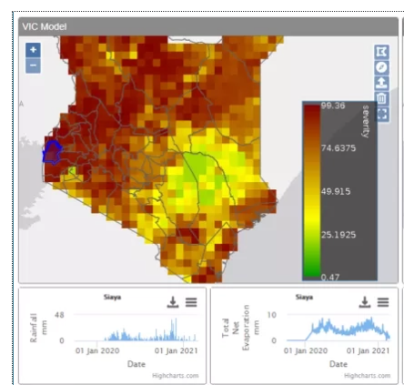
Flood Prevention Systems
02
Global and Local Solutions
Tackels the issue of natural disasters such as floods and can innovatively be used for crops.
Notes:
Now that we went over the root causes what are some of the technologies that can be implemented to alleviate these problems which will in turn solve insecurty. Well if the goal is to create wider acces to food then more food must be produced essentially. This idea revolves around the fundamental proncipal of supply and demand. The more crops that are available the less in value they will be which creates wider access to food especially across the impovershed demographic.
(Aussie ranked 12th in the world as a leading nation in food security) Rating Australia—a selection of global indexes – Parliament of Australia (aph.gov.au)
Israel is the world leader in wastewater recycling. Nearly 90% of wastewater in Israel is treated for reuse, most of it in agricultural irrigation1.
Flood prevtion systems input in Kenya That according to rti.org (ndependent, nonprofit research institute dedicated to improving the human condition) they collaborated with local experts to calibrate hydrolic models to simulate river flows from Global Ensemble Forcast sytem which produced 3-10 day forecast for river flows for the Pamba river and many others. Even according to nasa they can forecast crop conditions and know food commodities and volumes
GMOS-Genetically modified organism (GMO), organism whose genome has been engineered in the laboratory in order to favour the expression of desired physiological traits or the generation of desired biological products. According to a science article written and fact checked by biologists and geneticists Genetically modified organism (GMO) | Definition, Examples, & Facts | Britannica
Uncommon in Niger
Bangladesh adopted a genetically modifyed eggplant that reduced pestiside usage and infestation rate according to a sci journal published in 2018.Bt eggplant (Solanum melongena L.) in Bangladesh: Fruit production and control of eggplant fruit and shoot borer (Leucinodes orbonalis Guenee), effects on non-target arthropods and economic returns | PLOS ONE
Lastly, the implementation of these solutions create jobs UN water.org sates study in Latin America found that investing US$1 billion in expanding the water supply and sanitation network would directly result in 100 000 jobs.
Triple Threat: Helping Kenya Protect Against Floods, Locusts, and COVID | NASA Applied Sciences
Education resources - Recycled water - Hunter Water
Water Reuse in Agriculture — CONSERVE (conservewaterforfood.org)
Development of Drought-Tolerant Transgenic Wheat: Achievements and Limitations - PMC (nih.gov)

Slide 8
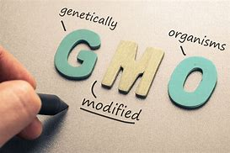
GMO's
02
Global and Local Solutions
Progress has been made to achieve drought resistant.
For instance, Argentina's approval of the world's first drought resistant HB4 wheat in 2020. (According to a scientific journal published in the National Library of Medicine.)
Notes:
Now that we went over the root causes what are some of the technologies that can be implemented to alleviate these problems which will in turn solve insecurty. Well if the goal is to create wider acces to food then more food must be produced essentially. This idea revolves around the fundamental proncipal of supply and demand. The more crops that are available the less in value they will be which creates wider access to food especially across the impovershed demographic.
(Aussie ranked 12th in the world as a leading nation in food security) Rating Australia—a selection of global indexes – Parliament of Australia (aph.gov.au)
Israel is the world leader in wastewater recycling. Nearly 90% of wastewater in Israel is treated for reuse, most of it in agricultural irrigation1.
Flood prevtion systems input in Kenya That according to rti.org (ndependent, nonprofit research institute dedicated to improving the human condition) they collaborated with local experts to calibrate hydrolic models to simulate river flows from Global Ensemble Forcast sytem which produced 3-10 day forecast for river flows for the Pamba river and many others. Even according to nasa they can forecast crop conditions and know food commodities and volumes
GMOS-Genetically modified organism (GMO), organism whose genome has been engineered in the laboratory in order to favour the expression of desired physiological traits or the generation of desired biological products. According to a science article written and fact checked by biologists and geneticists Genetically modified organism (GMO) | Definition, Examples, & Facts | Britannica
Uncommon in Niger
Bangladesh adopted a genetically modifyed eggplant that reduced pestiside usage and infestation rate according to a sci journal published in 2018.Bt eggplant (Solanum melongena L.) in Bangladesh: Fruit production and control of eggplant fruit and shoot borer (Leucinodes orbonalis Guenee), effects on non-target arthropods and economic returns | PLOS ONE
Lastly, the implementation of these solutions create jobs UN water.org sates study in Latin America found that investing US$1 billion in expanding the water supply and sanitation network would directly result in 100 000 jobs.
Triple Threat: Helping Kenya Protect Against Floods, Locusts, and COVID | NASA Applied Sciences
Education resources - Recycled water - Hunter Water
Water Reuse in Agriculture — CONSERVE (conservewaterforfood.org)
Development of Drought-Tolerant Transgenic Wheat: Achievements and Limitations - PMC (nih.gov)

Slide 9

Welfare Programs
02
Global and Local Solutions
Low-income families can receive food subsidies to help them purchase nutritious food.
However these programs do not lower poverty rate.
Welfare fraud.
Notes:
TANF (Temporary Assistance for Needy Families) – DUG Network
https://www.pncguam.com/snap-supplemental-emergency-allotment-issuances-for-july-released/
By Supplementing their grocier bill
Additionally according to the federalsafteynet.com "Improper welfare payments, including welfare fraud and welfare abuse, are estimated to be 13.3% of all federal welfare payments."

Slide 10
Foreign Policy
02
Global and Local Solutions
A nation's goals that direct its actions with other nations are referred to as its foreign policy.
Ineffective in other governments.
Provide excessive power to the country providing aid.
Notes:
By Supplementing their grocier bill
Additionally according to the federalsafteynet.com "Improper welfare payments, including welfare fraud and welfare abuse, are estimated to be 13.3% of all federal welfare payments."

Slide 11
Global Barriers
03
Global Barriers
Funding.
Lack of appropriate institutions.
Gender productivity gap.
Low knowledge.
Notes:
https://www.alamy.com/stock-photo/international-trade-barrier-barriers.html
Australia spends an estimated US$6 billion each year on water and wastewater treatment services
Have to rely on non-profits to get the job done
https://www.trade.gov/country-commercial-guides/australia-water-and-wastewater-treatment
Open Knowledge Repository (worldbank.org)

Slide 12
Local Barriers
04
Local Barriers
Residents may lack knowledge.
Unfamiliar foods.
Do not have density to sustain food outlets in some rural areas.
Notes:
New research looks to lower the high cost of desalination | Stanford University School of Engineering
Reducing specific energy consumption in Reverse Osmosis (RO) water desalination: An analysis from first principles - ScienceDirect reduces energy
Floods: No real way to stop a flood only prevention, countires may not have access to funds and tec

Slide 13
Decision Matrix
Conclusion
05
*ranked relative to each other | Cost | Complexity to implement | Effectiveness | Total:
G.M.O | 3.5 | 5 | 5 | 13.5
Reclaimed Water | 4 | 2 | 5 | 11
Flood prevention | ~3 | 1 | 1 | 5
1 – worst 2 3 4 5-Best
Notes:
All are expensive: buyinf of materials/tools, buildingg cost,
Orange County, for example, IPR costs $800-$850 to produce enough recycled water for 2 families of 4 for a year. Desalinating an equal amount of seawater would require $1,200-$1,800 because of the amount of energy needed.
From Wastewater to Drinking Water – State of the Planet (columbia.edu)
The floods in Kenya by end of May 2020 claimed up to 230 lives, displaced close to 350,000 people, affected approximately 800,000 according to United Nations Children Emergency Fund and led to active cholera outbreaks in five Kenyan counties (UNICEF, 2018). The response cost then to the Kenyan government was estimated at US $1 billion (GoK, 2019). There is also reported to be a clear increase in the frequency and intensity of reported climate-related impacts in recent years with some case studies projecting a likely increase in flooding due to extreme rainfall events (Fourth, 2011; World Bank, 2021).
Advancing operational flood forecasting, early warning and risk management with new emerging science: Gaps, opportunities and barriers in Kenya - Kiptum - Journal of Flood Risk Management - Wiley Online Library

Slide 14

Conclusion
05
Conclusion
GMO's ranked as the best solution to the issue of food insecurity despite its cost.
All three solutions are indeed viable to an extent.
Notes:
Advancing operational flood forecasting, early warning and risk management with new emerging science: Gaps, opportunities and barriers in Kenya - Kiptum - Journal of Flood Risk Management - Wiley Online Library

Slide 15
Bibliography
06
Bibliography
American Water Works Association. (2023, January 25). | AWWA members among delegates exploring Israeli water ... https://www.awwa.org/AWWA-Articles/awwa-members-among-delegates-exploring-israeli-water-recycling-programs
World Food Programme. (2023, April). Biography - Executive director Cindy H. McCain. UN World Food Programme. https://www.wfp.org/publications/biography-executive-director-cindy-h-mccain
World Food Programme. (2023b, July). Niger: World Food Programme. UN World Food Programme. https://www.wfp.org/countries/niger
Oxford English Dictionary. (n.d.). Food-insecurity noun - definition, pictures, pronunciation and ... https://www.oxfordlearnersdictionaries.com/definition/english/food-insecurity
Sultana, N., & Sabau, G. (2022, April 19). Food policy and food security in northern Bangladesh: An empirical study of the impact of food policy on Household Food Security. SSRN. https://papers.ssrn.com/sol3/papers.cfm?abstract_id=4087145
Notes:
Food Insecurity In Central Florida: Economic And Health Implications | Central Florida Foundation (cffound.org)
Water Reuse and Recycling | US EPA
Use of Reclaimed Water on Golf Courses (floridadep.gov)
Microsoft Word - DOCS-#620411-v1-Draft_Final_Board_Review_Water_Reuse_Fact_Sheet_10-23-20 (003).docx (pacewater.org)
Open Knowledge Repository (worldbank.org)
https://www.bluegreenalliance.org/resources/water-works-the-job-creation-potential-of-repairing-americas-water-infrastructure/
https://www.awwa.org/AWWA-Articles/awwa-members-among-delegates-exploring-israeli-water-recycling-programs#:~:text=Israel%20is%20a%20global%20leader,industrial%20sector%2C%20among%20other%20uses.

Slide 16
Bibliography
06
Bibliography
Crocker, L. (2021, September). Food insecurity in Central Florida: Economic and Health Implications. Central Florida Foundation. https://cffound.org/food-insecurity-in-central-florida-economic-and-health-implications/
Unites States Enviromental Protection Agency. (2023, May 17). EPA. https://www.epa.gov/waterreuse/basic-information-about-water-reuse
Florida Department of Environmental Proctection. (n.d.). Use of reclaimed water on golf courses. Use of Reclaimed Water on Golf Courses . https://floridadep.gov/sites/default/files/Reuse at golf courses.pdf
Florida Water Environmental Association. (n.d.). Pacewater. Fact Sheet on Reclaimed Water (Water Reuse). https://pacewater.org/documents/360/Fact-Sheet-on-Reclaimed-Water-Reuse.pdf
BlueGreen Alliance. (2020, July 1). Water works: The job creation potential of repairing America’s water infrastructure. https://www.bluegreenalliance.org/resources/water-works-the-job-creation-potential-of-repairing-americas-water-infrastructure/

Slide 17
Bibliography
06
Bibliography
Editor, G. (2021, February 23). GMOs in Bangladesh: Insect-resistant eggplant a sustainability success. here’s how the country can safeguard its progress. Genetic Literacy Project. https://geneticliteracyproject.org/2021/02/23/gmos-in-bangladesh-insect-resistant-eggplant-has-been-a-sustainability-success-but-pests-and-disease-threaten-its-future/
Ramthun, J. (n.d.). Triple threat: Helping Kenya protect against floods, locusts, and covid. NASA. https://appliedsciences.nasa.gov/our-impact/news/triple-threat-helping-kenya-protect-against-floods-locusts-and-covid
Conserve. (n.d.). Water reuse in agriculture. CONSERVE. https://conservewaterforfood.org/water-reuse-in-agriculture
Khan, S., Anwar, S., Yu, S., Sun, M., Yang, Z., & Gao, Z. (2019). Development of Drought-Tolerant Transgenic Wheat: Achievements and Limitations. International Journal of Molecular Sciences, 20(13), 3350. https://doi.org/10.3390/ijms20133350
‌

Slide 18
Bibliography
06
Bibliography
Feeding Florida. (n.d.). Hunger & Food Access. Feeding Florida | Florida’s Food Bank Network. https://www.feedingflorida.org/staying-informed/hunger-food-insecurity#:~:text=In%20Feeding%20America%27s%20Map%20the%20Meal%20Gap%20study,of%20Florida%27s%20children%20facing%20hunger%2C%20families%20make%20compromises.
corporateName=Commonwealth Parliament; address=Parliament House, C. (2020a, November 17). Rating Australia-A Selection of global indexes. Home – Parliament of Australia. https://www.aph.gov.au/About_Parliament/Parliamentary_Departments/Parliamentary_Library/pubs/rp/rp2021/AustraliaByNumbers
Feeding Florida. (n.d.). Hunger & Food Access. Feeding Florida | Florida’s Food Bank Network. https://www.feedingflorida.org/staying-informed/hunger-food-insecurity#:~:text=In%20Feeding%20America%27s%20Map%20the%20Meal%20Gap%20study,of%20Florida%27s%20children%20facing%20hunger%2C%20families%20make%20compromises.

Slide 19
Bibliography
06
Bibliography
Cho, R. (2011, April 4). From Wastewater to Drinking Water. State of the Planet. https://news.climate.columbia.edu/2011/04/04/from-wastewater-to-drinking-water/
Kiptum, A., Mwangi, E., Otieno, G., Njogu, A., Kilavi, M., Zacharia Mwai, MacLeod, D., Neal, J., Hawker, L., O’Shea, T., Halima Saado, Visman, E., Majani, B., & Todd, M. C. (2023). Advancing operational flood forecasting, early warning and risk management with new emerging science: Gaps, opportunities and barriers in Kenya. https://doi.org/10.1111/jfr3.12884
International Trade Administration. (2022, July 20). Australia - Water and Wastewater Treatment. Www.trade.gov. https://www.trade.gov/country-commercial-guides/australia-water-and-wastewater-treatment
Khan, S., Anwar, S., Yu, S., Sun, M., Yang, Z., & Gao, Z. (2019). Development of Drought-Tolerant Transgenic Wheat: Achievements and Limitations. International Journal of Molecular Sciences, 20(13), 3350. https://doi.org/10.3390/ijms20133350
Holden, D., & Ua, A. (n.d.). Access to Healthy Food in Florida Presentation to the Senate Committee on Agriculture. https://oppaga.fl.gov/Documents/Presentations/LILA%20presentation%201-7-22.pdf

Slide 20
Bibliography
06
Bibliography
Photos
Administration of Maps of World. (2021, July 1). Water crisis around the world. Around the World. https://www.mapsofworld.com/around-the-world/water-crisis.html
AHMED, A., BAKHTIAR, M. M., GILLIGAN, D., HODDINOTT, J., ROY, S., ANOWAR, S., GHOSTLAW, J., & THAI, G. (2021, January). Bangladesh.ifpri.info. https://bangladesh.ifpri.info/2021/10/latest-food-security-situation-in-bangladesh-data-collection-ongoing/
Snap supplemental emergency allotment for October released - PNC ... (n.d.). https://www.pncguam.com/snap-supplemental-emergency-allotment-for-october-released/
Notes:
Biography - Executive Director Cindy H. McCain | World Food Programme (wfp.org)
Niger | World Food Programme (wfp.org)
food insecurity - Quick search results | Oxford English Dictionary (oed.com)
Food policy and food security in Northern Bangladesh: An empirical study of the impact of food policy on household food security - ScienceDirect
Food Insecurity In Central Florida: Economic And Health Implications | Central Florida Foundation (cffound.org)
Water Reuse and Recycling | US EPA
Use of Reclaimed Water on Golf Courses (floridadep.gov)
Microsoft Word - DOCS-#620411-v1-Draft_Final_Board_Review_Water_Reuse_Fact_Sheet_10-23-20 (003).docx (pacewater.org)
Open Knowledge Repository (worldbank.org)
https://www.bluegreenalliance.org/resources/water-works-the-job-creation-potential-of-repairing-americas-water-infrastructure/
https://www.awwa.org/AWWA-Articles/awwa-members-among-delegates-exploring-israeli-water-recycling-programs#:~:text=Israel%20is%20a%20global%20leader,industrial%20sector%2C%20among%20other%20uses.

Slide 21
Thank You!

